Slide 1

Tic-Tac-Toe
Made by Radoslav Lisitsov, Kamelia Ivanova, Maria Kostova, Niya Runcheva, Georgi Vasilev and Kalina Noncheva

Slide 2

Contacts
Radoslav Lisitsov - RPLisitsov19@codingburgas.bg (Scrum Trainer)
Kamelia Ivanova - KIIvanova19@codingburgas.bg (Developer 1 Front End)
Maria Kostova - MDKostova19@codingburgas.bg (Developer 1 Front End)
Niya Runcheva – NSRuncheva19@codingburgas.bg (Developer 2 C++)
Georgi Vasilev – GAVasilev19@codingburgas.bg (Developer 3 Code Checker)
Kalina Noncheva – KPNoncheva19@codingburgas.bg (Developer 3 Code Checker)

Slide 3
History of the game
Tic-Tac-Toe, also knows as “game of Xs and Os”, is one of the most popular games. It is thought that an earlier version of the game has been played by the ancient Egyptians. Historians say, that the game has been played everywhere. In churches all over Rome and on the walls of some medieval English cathedrals.

Slide 4
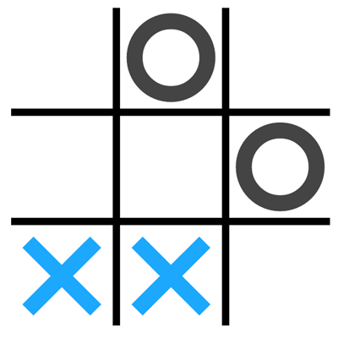
Elements of the game
3x3 play field
Circles and crosses, which the players place on the board

Slide 5
Rules of the game
It is played by two players. Each of them chooses a shape, a circle or a cross. Both players draw their symbol on the board when their turn comes.

Slide 6
How to win
The goal is to have three figures on one row, one column or in a diagonal shape. Whoever meets this condition first, wins the game.

Slide 7



Used programming technologies

Slide 8
Thank you for your attention!

